Slide 1
Suite Convert
SMART FILE CONVERTER
JUST SPEAK.

Slide 2






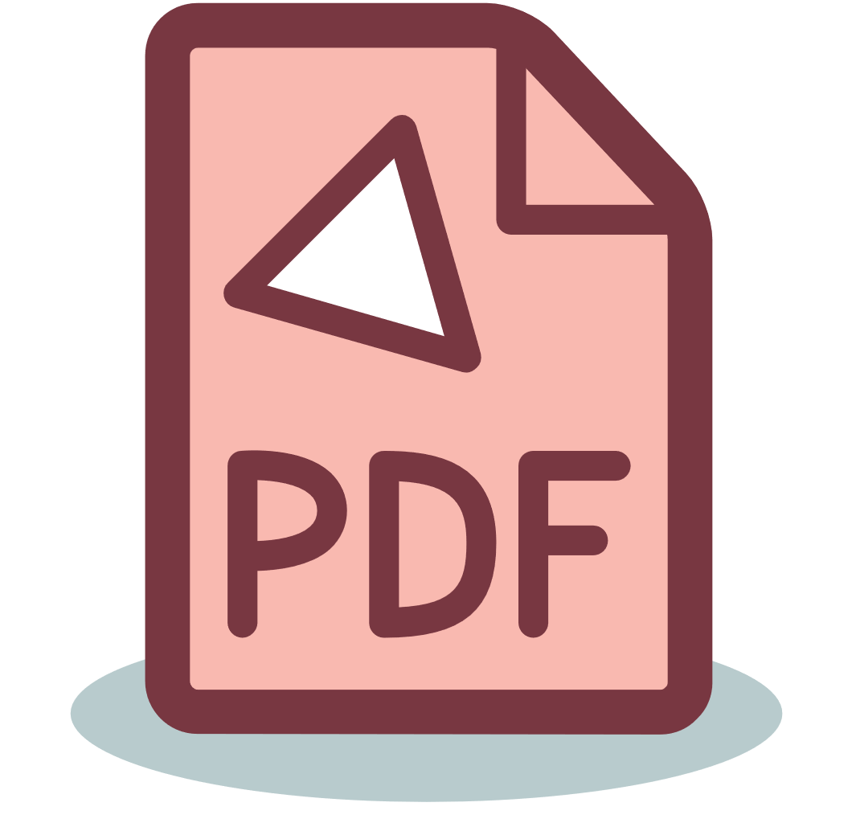




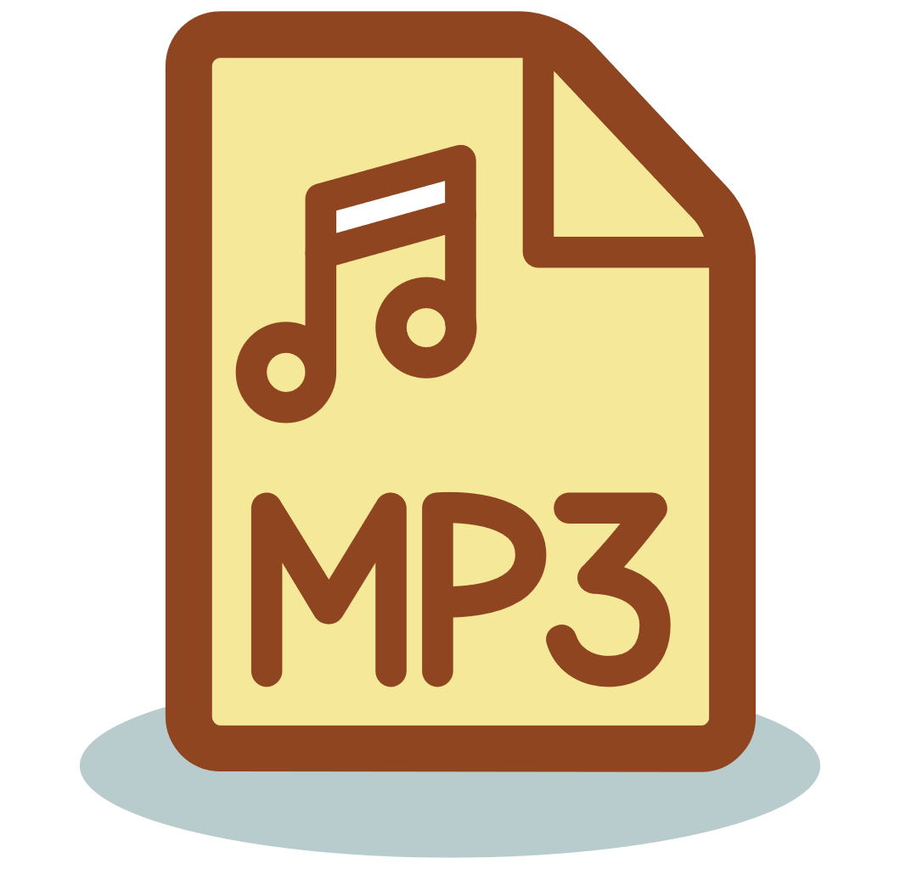


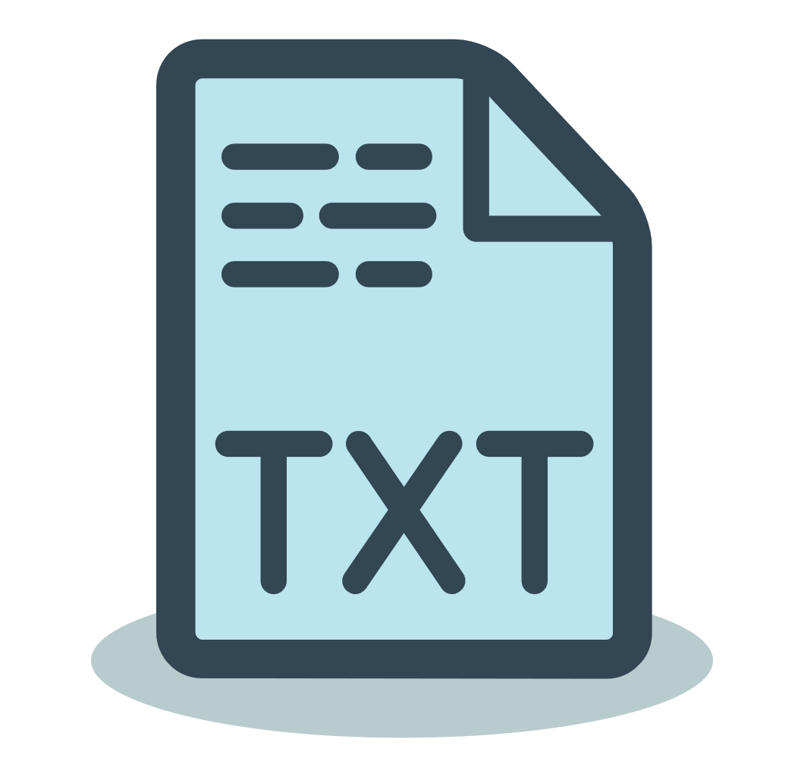

MAJOR FILE TYPES
.PNG
.JPG
It is the most frequently used uncompressed raster image format on the internet. This lossless data compression format
JPG is a popular file format used for images and graphics especially on the internet. It uses a compression algorithm that reduces sections of an image into blocks of pixels.
.DOCX
.PDF
DOCX is a document format used by Microsoft Word, but DOCX is more efficient and creates smaller, less corruptible files
PDF format is used when you need to save files that cannot be modified but still need to be easily shared and printed.
.MP3
.TXT
MP3 as a file format commonly designates files containing an elementary stream of MPEG-1 Audio or MPEG-2 Audio encoded data.
TXT is a file extension for a text file, used by a variety of text editors. There are several common formats, including ASCII and ANSI.

Slide 3



COMMUNICATE
COMPUTE
CONVERT
Speech Recognition
File Processing
File Conversion
Computer Recognizes The Speech
Computer Decodes The Speech To Understand User
Computer Algorithm Converts The User’s File Into Their Desired File Type

Slide 4
INITIATION
Analysis
The User Will Initiate The Code,
And Will Be Greeted By The Digital Assistant.
The Algorithm Will Process The User’s Voice And Provide With Appropriate Options To Choose From
CODE
EXECUTION
INPUT
The User Will Give Their Input Through Their Voice

Slide 5




FILE SELECTION
OUTPUT
An Input Box Will Prompt The User To Provide With Desired File
The Algorithm Will Convert The File Into The Desired File Type, And Save In User's Directory.
CONVERSION
The User Will Be Displayed With The Options For File Conversions

Slide 6




MEET THE TEAM
PRANAV GOEL
AARUSH SRIVASTAVA
NITISH SHARMA
ANIKET KHAJANCHI
20BCS4116
20BCS4110
20BCS4122
20BCS4098
https://github.com/iipranavii
https://github.com/Aarushsr12
https://github.com/itsnitish22
https://github.com/Aniketk257

Slide 7
THANK YOU

